Slide 1



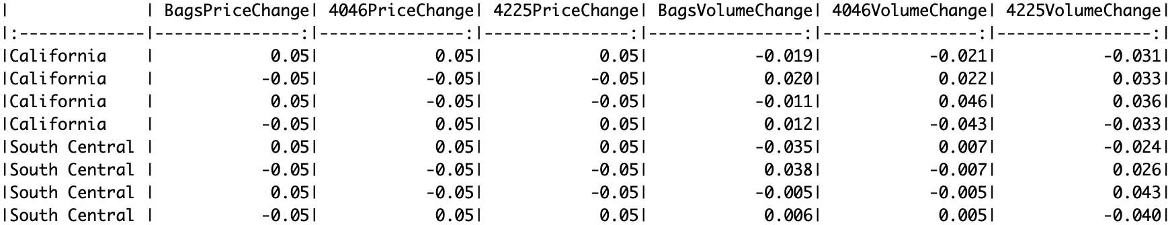




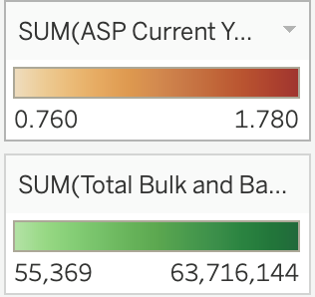

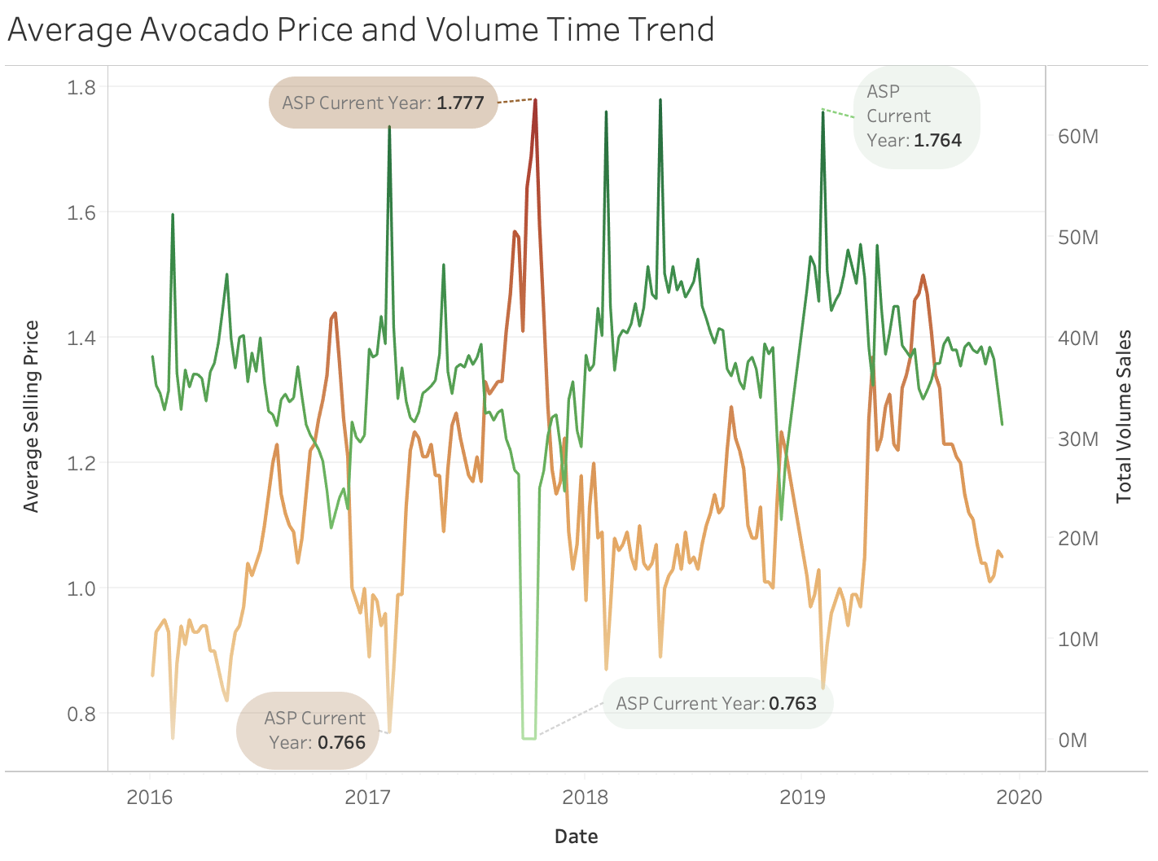
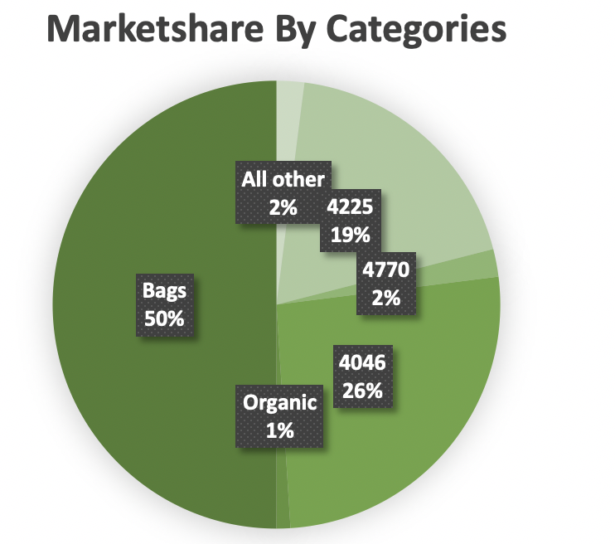
Avocado Price Elasticity Analysis
Eddie Wu, Roy Wang, Sam Chiang - BUS AN 514 - February 22, 2020
Introduction
Method
5% Price Change Analysis
Business problem
What are consumer preferences to Avocados by location and product type in the United States? There are five types of avocado products: 4046, 4225, 4770, Organic, and Bags.
The Data
The avocado data is pulled from https://hassavocadoboard.com/; the main columns include:
Date - the date of the observation
Year - the year of the observation
AveragePrice - the average price of a single avocado
Region - the city or region of the observation
Total Volume - Total number of avocados sold
4046 - Total number of avocados with PLU 4046 sold
4225 - Total number of avocados with PLU 4225 sold
4770 - Total number of avocados with PLU 4770 sold
Another dataset was mined from the website for elasticity analysis, with columns that include:
Year - the year of the observation
Quarter - the quarter of the observation
City - the city of the observation
Quarter - the selling quarter of the observation
P4046; P4225; P4770; PBags - the prices of the four products
V4046; V4225; V4770; Vbags - the volume of sales of the products
We apply price elasticities and demand models which we learnt in class to analyze the price elasticities and relevant factors impacting demands of avocados. The analytics tools e use in this project are R and Tableau.
To derive the price elasticity of Avocado, we use the following logistic regression to estimate the volume demanded with the product prices as independent variables while also factoring city, year, quarter:
We chose to separate Bags by itself because it has the largest market share and had the most significant coefficient in our model. We conducted a price change analysis with 4 scenarios:
All prices increase by 5%
All prices decrease by 5%
Bag prices increase by 5%, all else decrease by 5%
Bag prices decrease by 5%, all else increase by 5%
There was an obvious inverse effect on the change in prices to customer demand: as price goes up, volume decreases and vice versa. We see that 4225 has the highest volume reaction to the price changes in both regions. In both regions, a change in bags prices generally shows an inverse effect on the other products; however, the volume of bags do not fluctuate as significantly.People in South Central show less of reaction to price changes overall compared to California, although Californians react less to price changes of bags.
The Price elasticity (and the corresponding demand) can be categorized as:
1. Inelastic demand: −1 ≤ price elasticity < 0
2. Elastic demand: price elasticity < −1
Total Demand for avocados varies by major cities. Los Angeles has the highest demand volume, while Syracuse has the lowest demand volume. Cities have high volume demand tend to have relatively slow annual growth. These cities were originally divided into 8 regions and decided to pick 4 regions with highest volume demand to conduct the analysis, including California, West, South Central and Northeast.
We also use the following formula to calculate the percent change in volume using cross-price elasticities of demand given different pricing scenarios:
Results
EDA Analysis
Summary
Own Price Elasticity on Avocados
Region | Bags (own-price) | 4046 (own-price) | 4225 (own-price)
SouthCentral | -0.42 (mildly inelastic) | -0.1 (very inelastic) | -0.96 (unit elastic)
NorthEast | -0.17 (very inelastic) | -0.72 (mildly inelastic) | -1.26 (elastic)
West | -0.2 (very inelastic) | -0.02 (per-inelastic) | -0.56 (mildy inelastic)
California | -0.31 (very inelastic) | -0.42 (mildly inelastic) | -0.51(mildly inelastic)
As what we observed in the EDA, the price and demand of avocados in the U.S. has a intuitive inverse trend and the highest sales are during the first quarter of the year.
After finishing our analysis, we found that overall, Bags, which has the highest market share, had the lowest price elasticities in all regions. People didn’t react highly on its price changes, which may indicate that this is the favorite avocado product, especially in California. Product 4046’s price elasticities varied across the regions. Product 4225 is the most elastic in all regions.
We recommend not increasing 4225’s price to avoid decreased demand. Also, an increase in the price of bags could improve profit given its minimal change in volume while also increasing volume in other categories. Lastly, sellers can focus more on increasing their prices in the South Central region because customers don’t change buying behavior significantly.
One improvement could be done in our project: we had to manually type in the unit price data from the website which resulted in a limited dataset. If we can get more data points, the results will be much more significant for our elasticity model.
Demand Elasticity Model on Bags
Region | Bags(own-price) | 4046 (cross-price) | 4225 (cross-price)
SouthCentral | -0.42 (mildly inelastic) | 0.18 (week impact) | -0.49 (inverse impact)
NorthEast | -0.18 (very inelastic) | -0.01 (no impact) | 0.39 (positive impact)
West | -0.20 (very inelastic) | -0.24 (inverse impact) | -0.01 (no impact)
California | -0.31 (mildly inelastic) | -0.02 (no impact) | -0.06 (no impact)
Avocado prices see their peak at the beginning of the first quarter of the year, and dips at the end of the last quarter of the year. There was a giant dip in volume with a surge in price in late 2017 due to a weak harvest and insatiable demand for avocados. We saw that customers react highly to an increase in demand: a peak in price shows a mirrored dip in volume. Thus, we want to analyze the elasticities of avocados.
In these 4 regions, Bags has relatively to very inelastic demand; 4046 is more volatile in terms of price elasticity; 4225 tends to be more elastic. The price fluctuations of 4046 and 4225 does not have a huge impact on the sales of the Bags. For Bags, it’s own price elasticity ranges from 0.18 to 0.42, suggesting a relatively inelastic demand. From the results, we can conclude that Bags is flagship category of Avocado.
The market share chart shows that Organic type of avocado and the 4770 only takes 1% and 2% market share in 2019, respectively. Thus, we decided to exclude these two types of avocados for our price analysis.

